Slide 1
Beyond SQL: Intro to Graph Databases
Zach Beaver & Ryan McGibony
Data Scientists, Elder Research, Inc.
Notes:
Graph databases are only one kind of NoSQL database

Slide 2
Wait, I want to know about ANALYTICS! Not databases...
Goals of an effective approach to analytics:
View data from different angles
Explore relationships in the data
Analyze the influence of entities on others
Shorten data cleaning, exploration, and development cycles
Graph databases facilitate these goals!
Notes:
unlocking a whole new world of analytics. New angles on analytics problems -- from entity-centric to network-focused. And this fits back in with what you’re doing with more traditional analytics. not antagonistic but complementary. Don’t need specific examples, just hit these points.

Slide 3
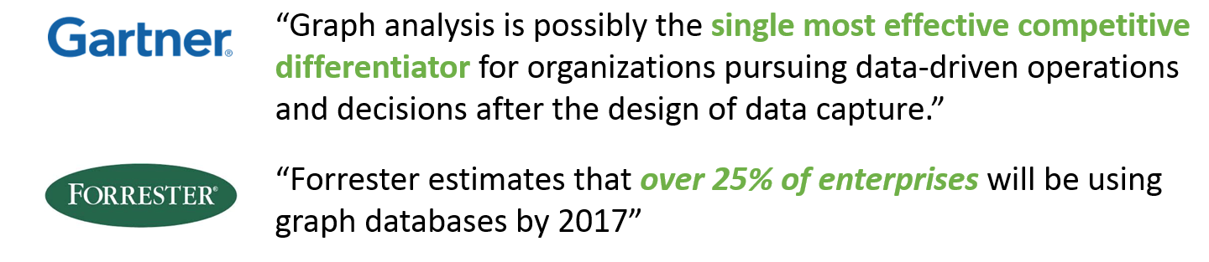
Hype or Substance?

Slide 4
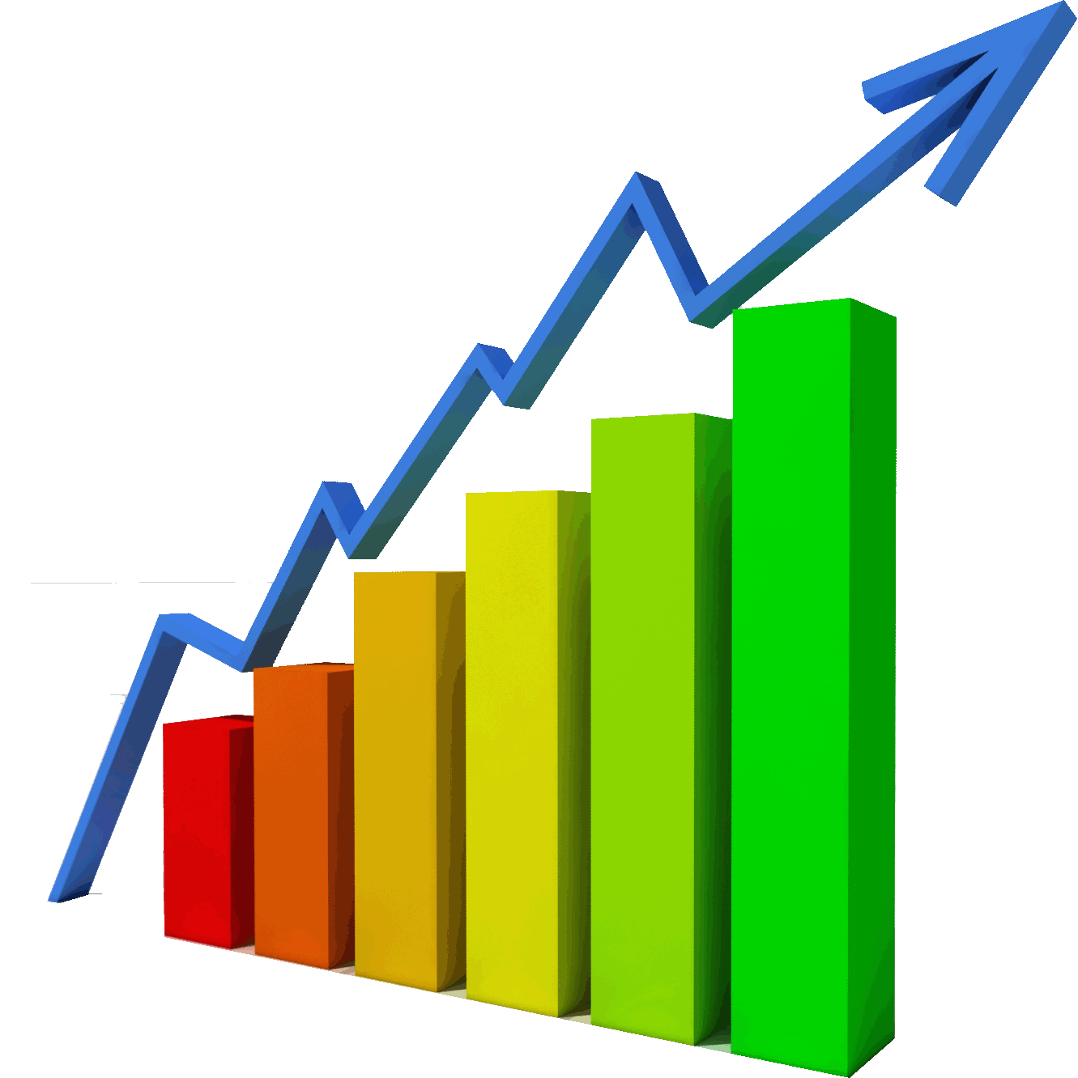
Graphs?

Slide 5
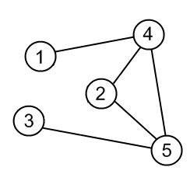

Graphs!

Slide 6
What Are Graph Databases?
Graph Databases store data by using:
Nodes
Married
Pam
Jim
Edges
Pranked
Properties
Date: “05-16-2007”
Description: “Stapler in Jello”
Dwight
Based on a branch of mathematics called Graph Theory
Data storage mimics this “Whiteboard” Representation

Slide 7
How Is This Different from Relational (SQL) Databases?
Relational (SQL) Databases store data using:
Tables
Rows
Columns
Primary/Foreign Keys
Based on Relational Algebra and Set Theory
Data Storage is Tabular
People
Person_ID 🔑
First_name
Last_name
Address
Phone
Marriages
Spouse1_ID 🔑
Spouse2_ID 🔑
Marriage_date
Pranks
Pranker_ID 🔑
Victim_ID 🔑
Prank_date
Description

Slide 8
Graph DBs vs. Relational DBs
Data model developed for storing RELATIONSHIPS
Data model developed for efficiently storing BUSINESS TRANSACTIONS
Efficient ad-hoc querying of relationships
Efficient aggregation and repeatable queries
The “Whiteboard model” IS the data model
Data model reflects the constraints of efficient storage and anticipated queries
Visualized or tabular output
Only tabular output
Schema-independent
Schema-dependent
Notes:
mention the distinction between RDBMS and data warehouses, where queryability is more important than storage efficiency.
Note: Graph DBs don’t replace Relational DBs; they complement them by being more amenable to certain tasks

Slide 9


A Tale of Two Analysts (in alternate DB universes)
Manager’s Request: “I want to know all direct reports and how many people they manage each, up to 3 levels down”
Sammy Sequel is using a fully normalized SQL Server Database
Gabby Graph is using a Graph Database called Neo4j

Slide 10
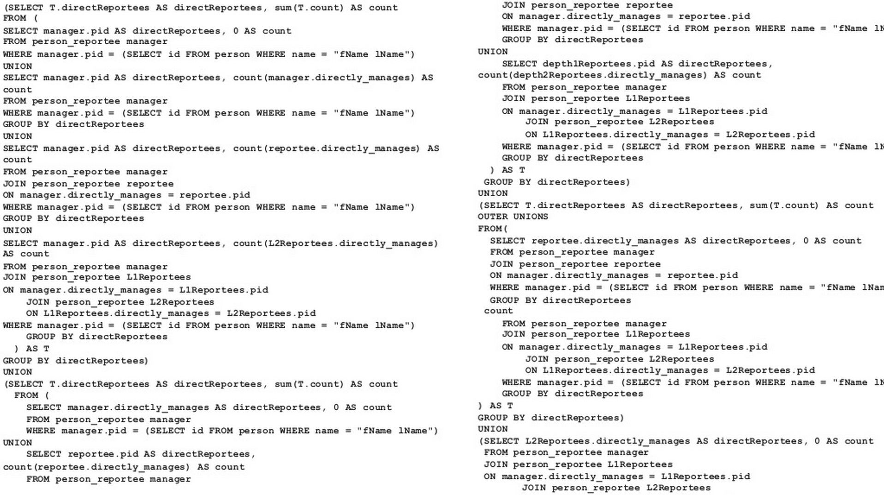

Sammy works hard all day and produces...
SQL Query
The Specs
Runtime: ~ 1 hour
Dev. Time: 4 hours
Sammy’s Stress: :-(
Code maintainability: :-(

Slide 11
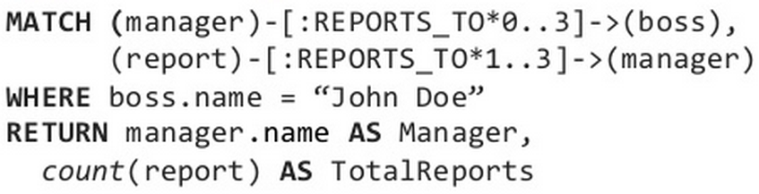
Gabby finishes her work quickly and produces...
Cypher Query
The Specs
Runtime: a few seconds
Dev. Time: 15 minutes
Gabby’s Stress: :-)
Code maintainability: :-)
Ironic Take-away: Relational Databases aren’t ideal for exploring RELATIONSHIPS

Slide 12
From RDBMS… …to Graph
Return
Customers
CustomerID 🔑
CompanyName
ContactName
Address
Phone
Returns
ReturnID🔑
CustomerID
EmployeeID
ReturnDate
Amount
Employees
EmployeeID 🔑
FirstName
LastName
Address
Phone
REQUESTED
PROCESSED
Cust
Emp
Addr
Phone

Slide 13
Let’s see a graph database in action!
Notes:
why Neo4j? open source, easy to use, leader in the industry

Slide 14
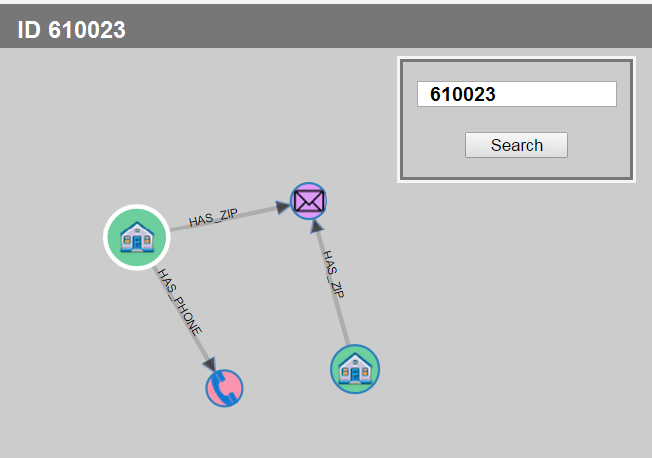
A No-Code Version

Slide 15
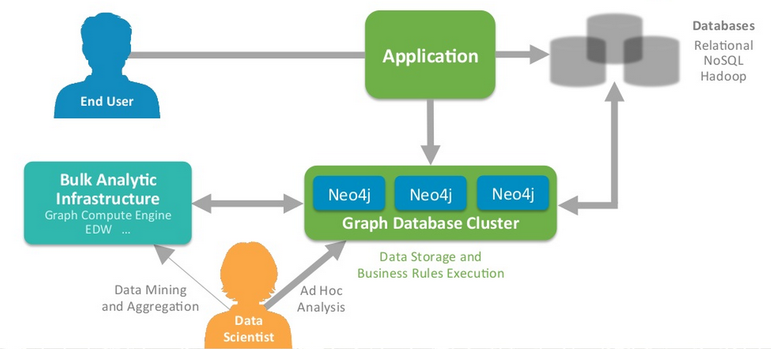
Graph DBs and an Analytics Workflow

Slide 16
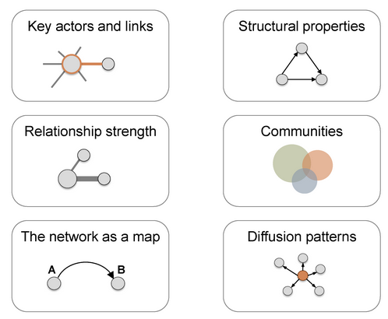
How Do Graphs Support Analytics?

Slide 17
Risk Propagation (Pre-Propagation)
Legend
bad actor
“good” actor
partners with

Slide 18
Propagating Risk
Legend
bad actor
“good” actor
partners with

Slide 19
After Propagating Risk
Legend
bad actor
“good” actor
partners with

Slide 20
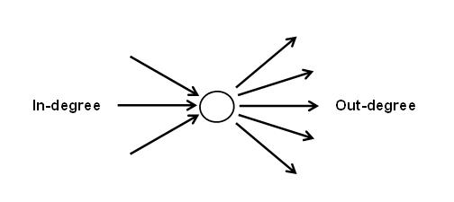
Network Statistics = Model Features
In/out Degree
Betweenness
Closeness
PageRank
Many More...

Slide 21
Original Analytics Base Table
Predictors
Outcome
Occupation | Education | Years Employed | Num. of Past Violations | Branch
Engineer | Bachelors | 1 | 0 | New York
Custodian | GED | 14 | 1 | Nashua
Analyst | Masters | 1 | 3 | Scranton
… | … | … | … | …
Violation in next 30 Days?
0
0
1
…

Slide 22
Augmented Analytics Base Table
Original Predictors
Network Features
Outcome
Occupation | Education | Years Employed | Num. of Past Violations | Branch | Betweenness | Page Rank | Risk Prop.
Engineer | Bachelors | 1 | 0 | New York | 1.6 | 1.7 | 0.1
Custodian | GED | 14 | 1 | Nashua | -1.3 | -2.0 | 1.2
Analyst | Masters | 1 | 3 | Scranton | 2.0 | 2.4 | 2.8
… | … | … | … | …
Violation in next 30 Days?
0
0
1
…

Slide 23
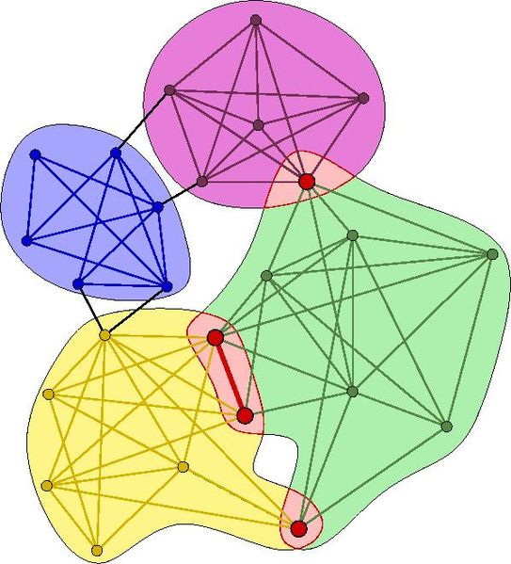
Finding Your Network’s “Communities”

Slide 24





Who Is Using Graph Databases?
And many more...
Notes:
Points:
-Audience is familiar with Graph DBs even if they don’t realize it
-Can be used at-scale for customer-facing, real-time, but also useful for facilitating analytics (research, data exploration etc.)

Slide 25


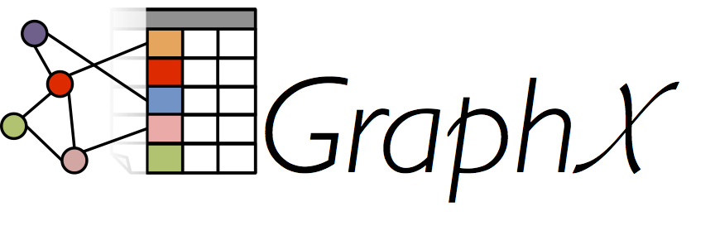






Technology
Databases
Analytics Tools

Slide 26
What You Should Take Away
Graph databases...
Are great for understanding relationships
Facilitate time savings on multiple fronts
Unlock new analysis opportunities
Complement your existing analytics work
In your organization: How could a graph approach be employed to solve problems?

Slide 27
Special Thanks To...
Ryan Boyd (Neo Technology)
Katya Ognyanova (RPubs Viz)

Slide 28
Thank You! Contact Us with Any Questions!
Zach Beaver
zach.beaver@elderresearch.com
(855) 973-7673 ext. 721
Ryan McGibony
ryan.mcgibony@elderresearch.com
(855) 973-7673 ext. 724

